Slide 1

GFBio – Education module
Propose
Lesson in Data Management Planning

Slide 2
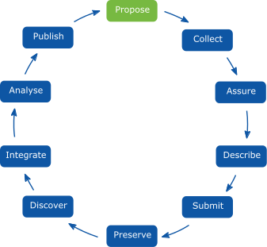


Propose
Data Management begins at the planning and proposal phase of the research project
Data Management Plans (DMPs) are ideally established at this point
Planning begins with checklist to assist in development of your DMP
Important: DMPs must be continuously maintained and kept up-to-date throughout your study

Slide 3
Propose
Why is a Data Management Plan important?
It will be easier to preserve your data.
By planning ahead, data management problems can be handled or avoided.
It saves time in the long run! (you prevent duplication of effort)
Can lead to new, unanticipated discoveries.
It increases transparency of your data and your integrity.
It may be a funding agency requirement.
What is a data management plan?
a formal document
outlines what you do with your data during and after project
Plan in mind often inadequately documented and incomplete.

Slide 4
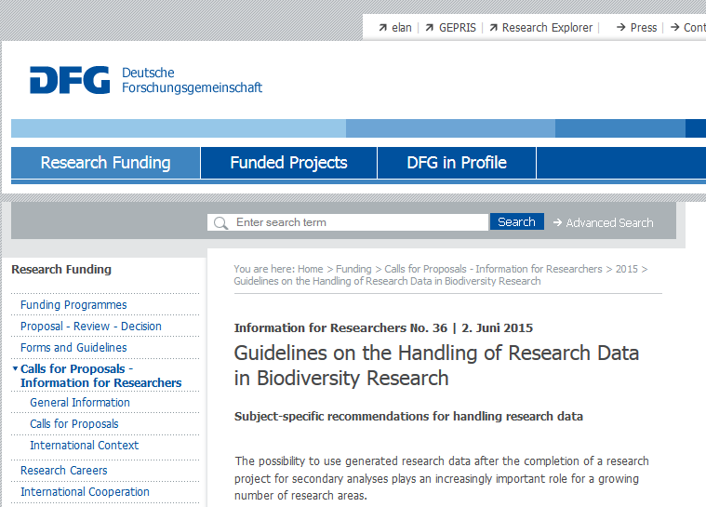
Propose
www.dfg.de/download/pdf/foerderung/antragstellung/forschungsdaten/guidelines_biodiversity_research.pdf
Notes:
In June 2015, GFBio contributed in drawing up DFG Guidelines on the handling of research data in biodiversity research: http://www.dfg.de/en/research_funding/announcements_proposals/2015/info_wissenschaft_15_36/index.html

Slide 5
Propose
The DFG aims to „enhance the long-term archiving and curation of research data“ and therefore „funds projects that seek to achieve an efficient re-use of research data“...Consequently, it expects corresponding statements in project proposals….
…
All research projects/proposals should include a data management plan. The plan should – to the extent applicable – comprise the following information:
  Reproducibility (onetime observations, repeatable experiments);
  Kind (individual, tissue, etc.) and type of data (picture, audio, text, source code, numbers);

Slide 6
Propose
The DFG aims to „enhance the long-term archiving and curation of research data“ and therefore „funds projects that seek to achieve an efficient re-use of research data“...Consequently, it expects corresponding statements in project proposals….
…
All research projects/proposals should include a data management plan. The plan should – to the extent applicable – comprise the following information:
  Reproducibility (onetime observations, repeatable experiments);
  Kind (individual, tissue, etc.) and type of data (picture, audio, text, source code, numbers);

Slide 7
Propose
The DFG aims to „enhance the long-term archiving and curation of research data“ and therefore „funds projects that seek to achieve an efficient re-use of research data“...Consequently, it expects corresponding statements in project proposals….
…
All research projects/proposals should include a data management plan. The plan should – to the extent applicable – comprise the following information:
  Reproducibility (onetime observations, repeatable experiments);
  Kind (individual, tissue, etc.) and type of data (picture, audio, text, source code, numbers);

Slide 8
Propose
  Tools used for data collection/evaluation/processing
  File formats (recommended use of open formats)
  Documentation/description of the data (context of the investigations, methods used, etc.); use standards
  Administration, storing and security of data during project runtime
  Quality assurance
  Referenced data (e.g. voucher specimen or soil samples)
  Person in charge for data management
  - l) Conditions about long-term visibility, accessibility, re-use
  Costs of research data management during the project and their long-term re-use, who pays?

Slide 9
Propose
  Tools used for data collection/evaluation/processing
  File formats (recommended use of open formats)
  Documentation/description of the data (context of the investigations, methods used, etc.); use standards
  Administration, storing and security of data during project runtime
  Quality assurance
  Referenced data (e.g. voucher specimen or soil samples)
  Person in charge for data management
  - l) Conditions about long-term visibility, accessibility, re-use
  Costs of research data management during the project and their long-term re-use, who pays?

Slide 10
Propose
  Tools used for data collection/evaluation/processing
  File formats (recommended use of open formats)
  Documentation/description of the data (context of the investigations, methods used, etc.); use standards
  Administration, storing and security of data during project runtime
  Quality assurance
  Referenced data (e.g. voucher specimen or soil samples)
  Person in charge for data management
  - l) Conditions about long-term visibility, accessibility, re-use
  Costs of research data management during the project and their long-term re-use, who pays?

Slide 11
Propose
  Tools used for data collection/evaluation/processing
  File formats (recommended use of open formats)
  Documentation/description of the data (context of the investigations, methods used, etc.); use standards
  Administration, storing and security of data during project runtime
  Quality assurance
  Referenced data (e.g. voucher specimen or soil samples)
  Person in charge for data management
  - l) Conditions about long-term visibility, accessibility, re-use
  Costs of research data management during the project and their long-term re-use, who pays?

Slide 12
Propose
  Tools used for data collection/evaluation/processing
  File formats (recommended use of open formats)
  Documentation/description of the data (context of the investigations, methods used, etc.); use standards
  Administration, storing and security of data during project runtime
  Quality assurance
  Referenced data (e.g. voucher specimen or soil samples)
  Person in charge for data management
  - l) Conditions about long-term visibility, accessibility, re-use
  Costs of research data management during the project and their long-term re-use, who pays?

Slide 13
Propose
  Tools used for data collection/evaluation/processing
  File formats (recommended use of open formats)
  Documentation/description of the data (context of the investigations, methods used, etc.); use standards
  Administration, storing and security of data during project runtime
  Quality assurance
  Referenced data (e.g. voucher specimen or soil samples)
  Person in charge for data management
  - l) Conditions about long-term visibility, accessibility, re-use
  Costs of research data management during the project and their long-term re-use, who pays?

Slide 14
Propose
  Tools used for data collection/evaluation/processing
  File formats (recommended use of open formats)
  Documentation/description of the data (context of the investigations, methods used, etc.); use standards
  Administration, storing and security of data during project runtime
  Quality assurance
  Referenced data (e.g. voucher specimen or soil samples)
  Person in charge for data management
  - l) Conditions about long-term visibility, accessibility, re-use
  Costs of research data management during the project and their long-term re-use, who pays?

Slide 15
Propose
  Tools used for data collection/evaluation/processing
  File formats (recommended use of open formats)
  Documentation/description of the data (context of the investigations, methods used, etc.); use standards
  Administration, storing and security of data during project runtime
  Quality assurance
  Referenced data (e.g. voucher specimen or soil samples)
  Person in charge for data management
  - l) Conditions about long-term visibility, accessibility, re-use
  Costs of research data management during the project and their long-term re-use, who pays?

Slide 16
Propose
  Tools used for data collection/evaluation/processing
  File formats (recommended use of open formats)
  Documentation/description of the data (context of the investigations, methods used, etc.); use standards
  Administration, storing and security of data during project runtime
  Quality assurance
  Referenced data (e.g. voucher specimen or soil samples)
  Person in charge for data management
  - l) Conditions about long-term visibility, accessibility, re-use
  Costs of research data management during the project and their long-term re-use, who pays?

Slide 17





Propose
To sum up: 5 Key components of a DMP
Information about data & data format
Metadata content and format
Policies for access, sharing and re-use
Long-term storage and data management
Budget

Slide 18
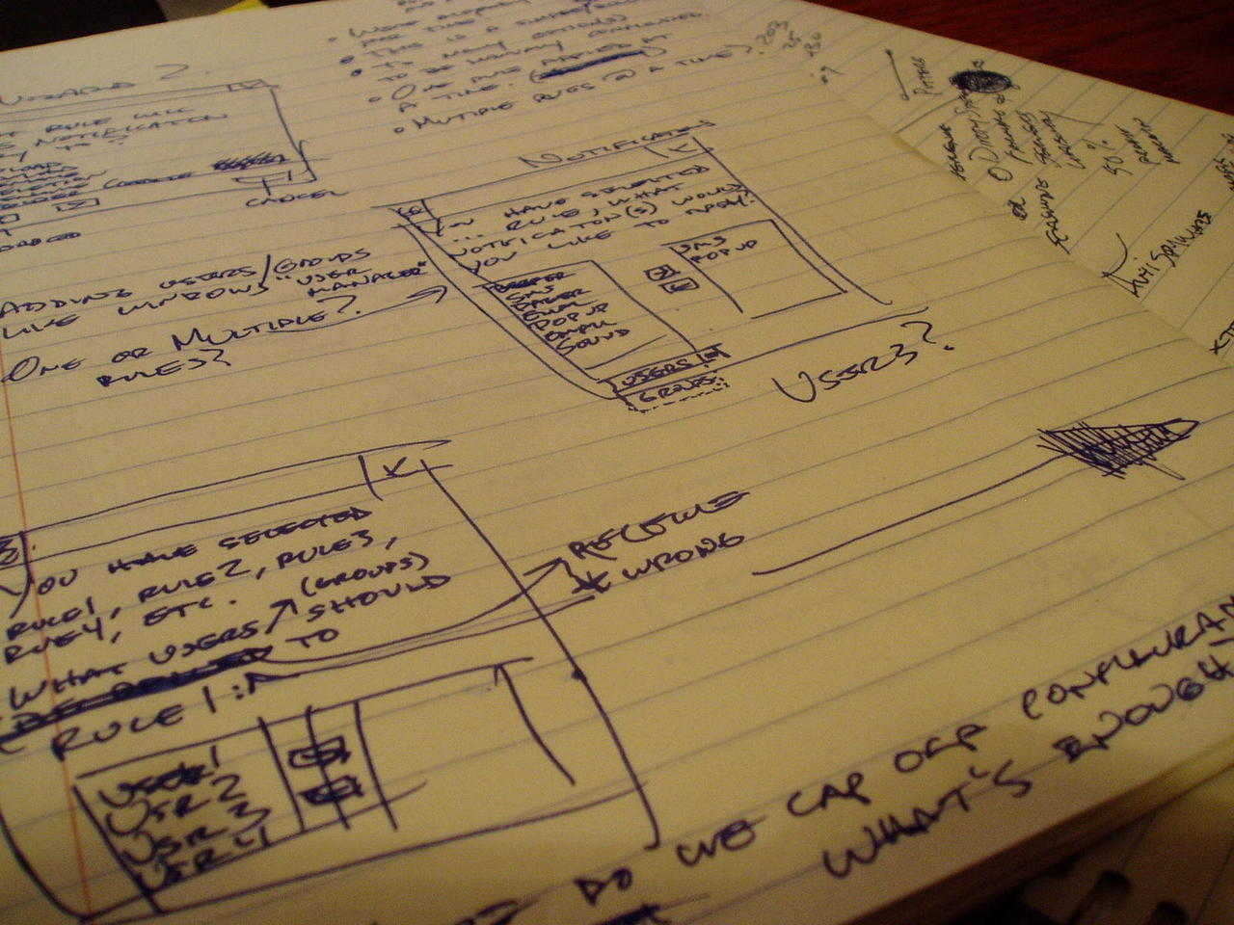
Propose
  Data Description & Data Format
    Experimental
    Observational
    Raw or derived
    Physical collections
    Models and their outputs
    Simulation outputs
    Curriculum materials
    Software
    Images
    Etc…

Slide 19
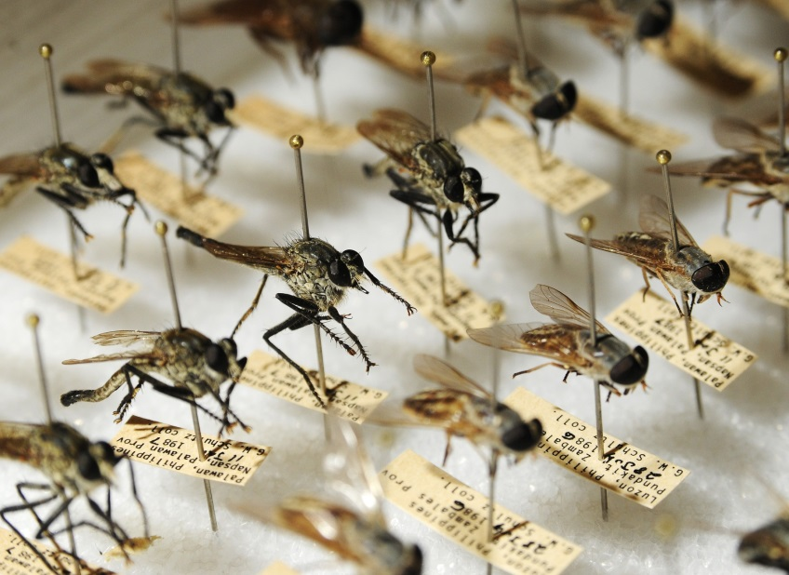


Propose
  Data Description & Data Format
  How, when and where will the data be acquired?
  Processing of the data
    Software used
    Algorithms
    Workflows

Slide 20











Propose
  Data Description & Data Format
  File formats
    Justification
    Naming conventions
  Quality assurance & control during sample collection, analysis, and processing

Slide 21


Propose
  Data Description & Data Format
  Re-use data
    Will you combine your data with existing data?
    What is their relationship?
    Origin?
  Short-term management
    Version control
    Back up
    Security & protection
    Responsibilities

Slide 22
Propose
  Metadata – content and format
  Metadata Definition
    Documentation and reporting of data
    Contextual details: Critical information about the dataset
    Information important for using the data
    Descriptions of temporal and spatial details, instruments, parameters, units, files, etc.
Juliane Steckel 29./30.08.2015 GFO Pre-Meeting Workshop DM GFBio

Slide 23
Propose
  Metadata – content and format
  What metadata are needed
    Any details that make data meaningful
  How metadata will be created and/or captured
    Lab notebooks? GPS units?
    Auto-saved on instrument?
  What format will be used for the metadata
    Standards for community
    Justification for format chosen
Juliane Steckel 29./30.08.2015 GFO Pre-Meeting Workshop DM GFBio

Slide 24

Propose
  Policies for access, sharing, re-use
    Obligations for sharing
    International organizations
    Funding agencies
    Institutions
    Journals
PLOS One
„PLOS journals require authors to make all data underlying the findings described in their manuscript fully available without restrictions, with rare exceptions.“
Nature
„A condition of publication in a Nature journal is that authors are required to make materials, data and associated protocols promptly available to readers without undue qualifications.”
Juliane Steckel 29./30.08.2015 GFO Pre-Meeting Workshop DM GFBio

Slide 25

Propose
  Policies for access, sharing, re-use
    Details of data sharing
      How long?
      When?
      How access can be gained?
      Data collector rights
    Ethical/privacy issues with data sharing
Juliane Steckel 29./30.08.2015 GFO Pre-Meeting Workshop DM GFBio

Slide 26
Propose
  Policies for access, sharing, re-use
    Intellectual property & copyright issues
      Who owns the copyright?
      Institutional policies
      Funding agency policies
      Embargos for political/commercial reasons

Slide 27
Propose
EU: European Court Of Justice:
To claim copyright protection, a product has „to be original in the sense that it is its authors own intellectual creation”.
BMC Research Notes 2014:3
DE: Copyright is claimed by the creator of an original work BUT
Copyright ≠ Right of use
Kahlberg 2008:42f
In sum, this originality refers to the form of presentation, not to the content. There is no copyright for (unprocessed) research data!

Slide 28
Propose
  Policies for access, sharing, re-use
    Intended future uses/users for data
    Citation
      How should data be cited when used?
      Persistent citation?

Slide 29
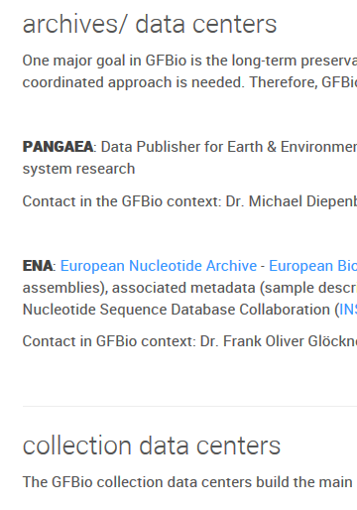

Propose
Long-term storage & Data Management
  What data will be preserved
  Where will it be archived
    Most appropriate archive for data
    Community standards
  Data transformations/formats needed
    Consider archive policies
  Who will be responsible
    Contact person for archive
www.gfbio.org

Slide 30

Propose
Budget
  Time for data preparation & documentation
  Hardware/software for data preparation & documentation
  Personnel
  Archive costs
  How costs will be paid

Slide 31
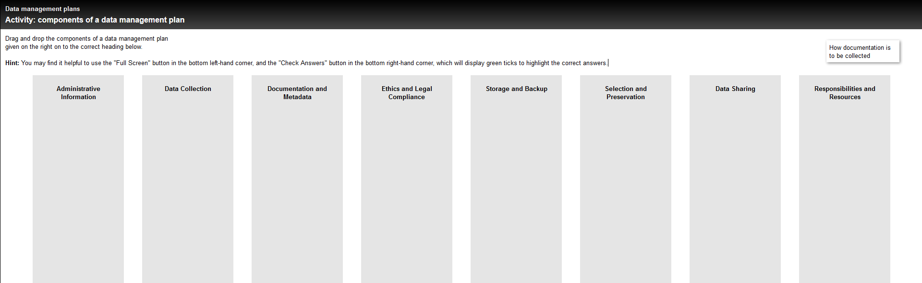
Propose
Please enter http://datalib.edina.ac.uk/mantra/datamanagementplans/
Go to page 16 and follow the instructions until you finished.
Check your answers.

Slide 32
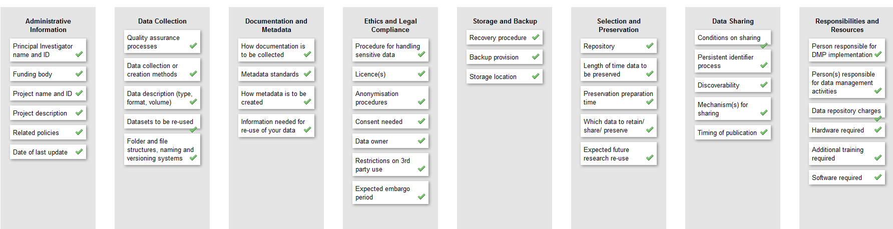
Propose
The correct answers are:
You can find a checklist of this structure available at: www.dcc.ac.uk/sites/default/files/documents/resource/DMP_Checklist_2013.pdf

Slide 33
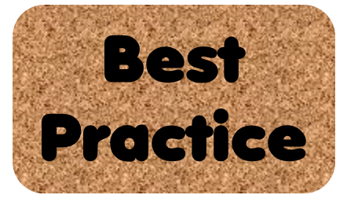
Propose
Use the planning checklist to start with.
Check if your group's Institute/ Research Centre has got a DMP that you can have a look at.
Use the DMP topics provided in this workshop to develop your own DMP.
Ask for help when you need it!

Slide 34
Propose
First fill in the sections important to you or your research. Add the sections you don't have any information later.
Keep it practical and simple, don't spend too much time.
DMPs are ‘live documents’, thus review your DMP regularly during your project.

Slide 35
Propose
You benefit!
You get accurate, complete, reliable and secure research data, during and after your study.
You gain understanding of data management terminology and issues.
You gain understanding of your project.

Slide 36
Propose
Generate a DMP owned by you and your workshop-neighbour!
Launch the DMPTool website: https://dmponline-test.dcc.ac.uk/
Familiarize yourself with its contents.
Use the Help-Section (Example DMPs), watch the Screencast
Create an account and log in.
Create a new data management plan and fill out the various sections.
Add a co-owner.
Export the DMP as PDF.
Guidance from institutions or funders might not fit to german institutes or funders. In this case, just play around, it‘s a game.
Prospectively, a tool appropriate to german institutions and funders, will be available…

Slide 37
  Useful Links & Resources
  Black icons made by Freepik from www.flaticon.com
  Digital Curation Centre’s DMPonline tool: https://dmponline.dcc.ac.uk/ (Users in USA: https://dmptool.org/ University of California's DMPTool)
  Interactive Teaching Mondules MANTRA: http://datalib.edina.ac.uk/mantra/datamanagementplans/
DFG-Proposal Preparation Instructions: http://www.dfg.de/formulare/54_01/
DFG Guidelines on the handling of data: www.dfg.de/download/pdf/foerderung/antragstellung/forschungsdaten/guidelines_biodiversity_research.pdf
DataONE Education Module: Data Management Planning. DataONE. Retrieved Nov12, 2012. From http://www.dataone.org/sites/all/documents/L03_DataManagementPlanning.pptx

Slide 38

Further Education Modules are downloadable from:
http://www.gfbio.org/education-modules
Suggested citation:
GFBio Education Module: Propose - Lesson in Data Management Planning. GFBio. Retrieved Nov23, 2015. From http://www.gfbio.org/education-modules
Copyright license information:
GFBio Education Module: Publish - Lesson in Data Publishing. by GFBio is licensed under a Creative Commons Attribution-NonCommercial 4.0 International License.

